Slide 1
Alpha
Garbage
A Simple Solution to garbage detection & classification.

Slide 2
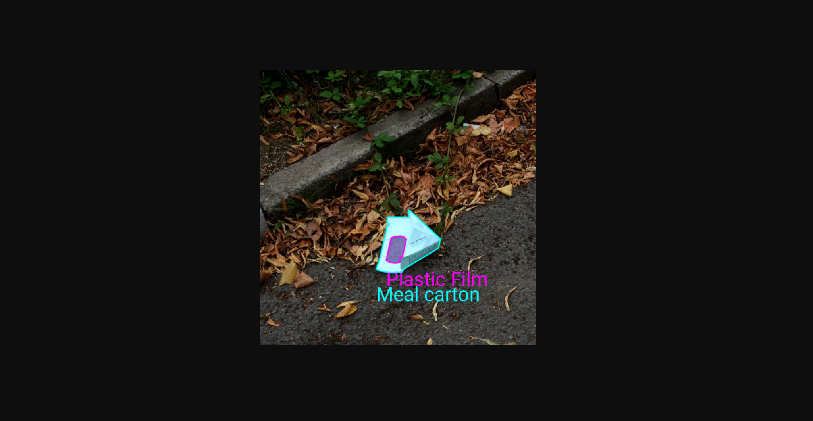
Project goal
Alpha
Garbage
Boundary detection
Garbage type classification

Slide 3
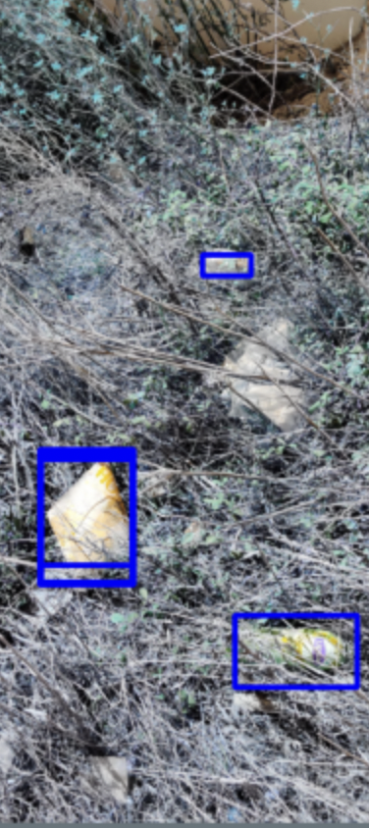
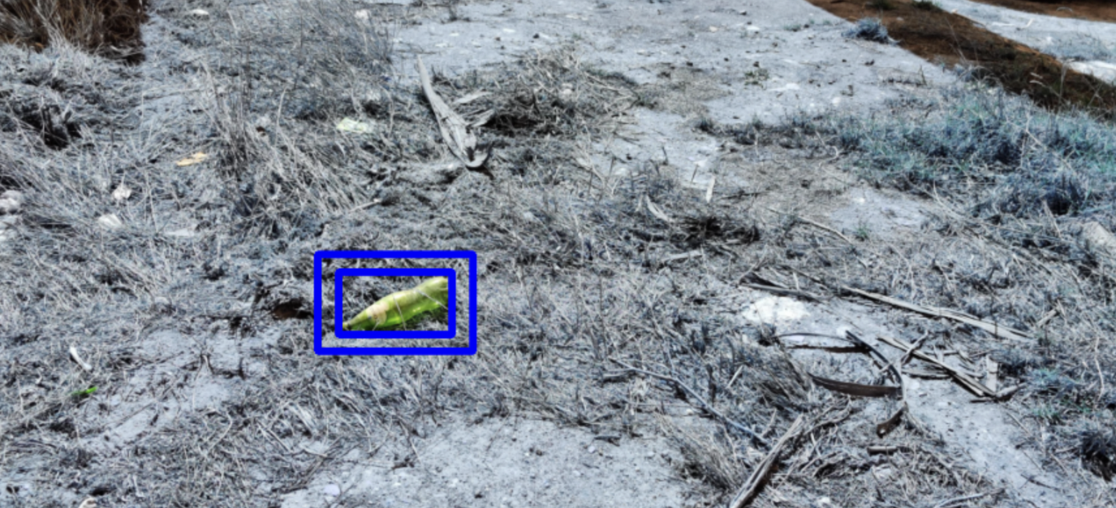
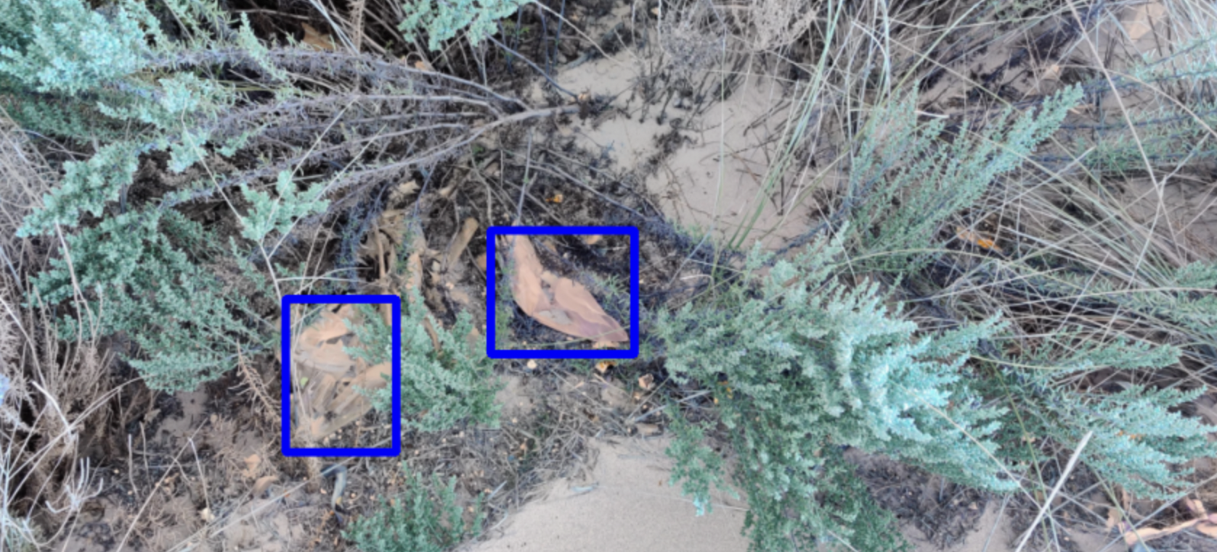
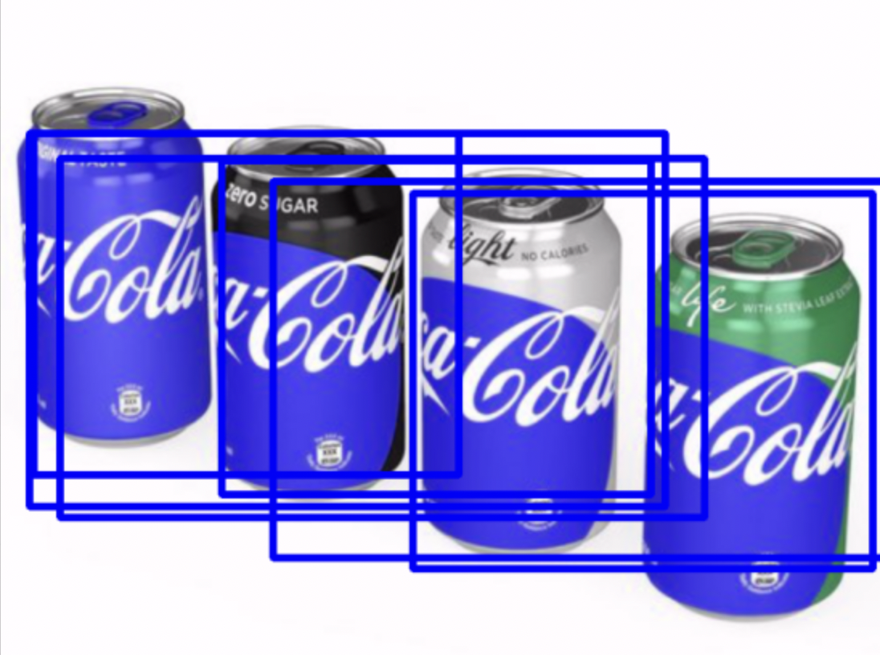
What we did to try and achieve the goal
Alpha
Garbage
RetinaNet
Boundary detection
Bad Performance when garbage are gathered/ covered
MobileNetV2

Slide 4
What we did to try and achieve the goal
Alpha
Garbage
RetinaNet
MobileNetV2

Slide 5
What went well & didn’t go well
Alpha
Garbage
What went well
Our models are able to detect the garbage from different environments
Our models are able to classify the garbage
Didn’t go well
Some of the categories do not exist in pre-built model, so we did a mapping to make it fit
RetinaNet is slow, hard to tune hyperparameters

Slide 6
Possible solutions & improvements
Alpha
Garbage
Overall level:
More garbage class type
More accurate boundary detection
Model level:
RetinaNet is sensitive to learning rate, using lr_scheduler to control learning rate
More hyperparameter tuning

Slide 7
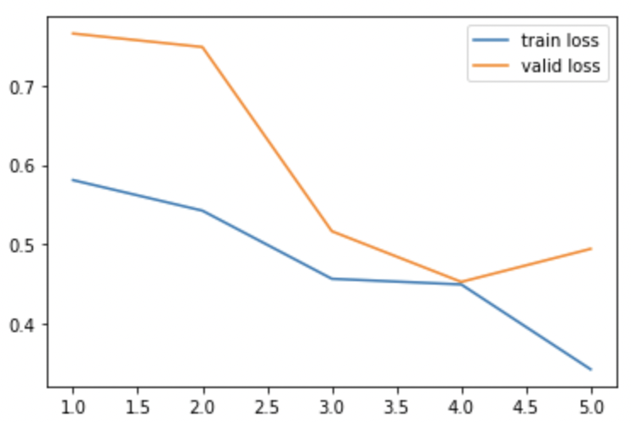
Performance metrics
Alpha
Garbage
Object detection
Loss

Slide 8
Thank You!
Alpha
Garbage

